Slide 1
Multi-f₀ MIDI-to-MIDI Similarity Evaluation for Piano Transcription Model Testing
Presented by: Alex Chuk, Jiawen Mao
Dec. 12, 2022

Slide 2
Introduction
Score Following vs Music Synchronization/Transcription
Task: Evaluate piano transcription MIDI generated with Piano Scribe, a web application implementation of the following paper:
Hawthorne, C., Elsen, E., Song, J., Roberts, A., Simon, I., Raffel, C., ... & Eck, D. (2017). Onsets and frames: Dual-objective piano transcription. arXiv preprint arXiv:1710.11153.
Piano Scribe link: https://piano-scribe.glitch.me
Notes:
Talk about Piano Scribe:
Onset and Frames, relation with Google Magenta
End at: 0:30

Slide 3
Dataset
Recorded in Dolan with the Yamaha Disklavier Piano
Microphones: 1 spot (Sennheiser MKH8040), 2 near-field (Shure SM58, Neumann U87)
Output: audio track; MIDI track perfectly aligned with audio
Pieces:
J. S. Bach: Prelude in C (bars 1 - 11), labeled Bach [2 players]
Debussy: Arabesque No. 2 (bars 5 - 14), labeled Debussy1 [2 players]
Debussy: Arabesque No. 2 (bars 28 - 36), labeled Debussy2 [2 players]
Gingko Leaves (original composition), labeled Leaves [only 1 player]
Tracks and Data Augmentation:
21 clean recordings: 7 pieces and 3 microphones for each
21 noised recordings: Re-recorded internally with added pink noise in Pro Tools
MIDI:
7 ground truth MIDI files (reference - refMIDI) for each piece
42 estimation MIDI files (estimation - estMIDI) generated with Piano Scribe
Notes:
End at: 1:00
repertoire:
1. classical realm
2. vary in dynamics and style: baroque /

Slide 4
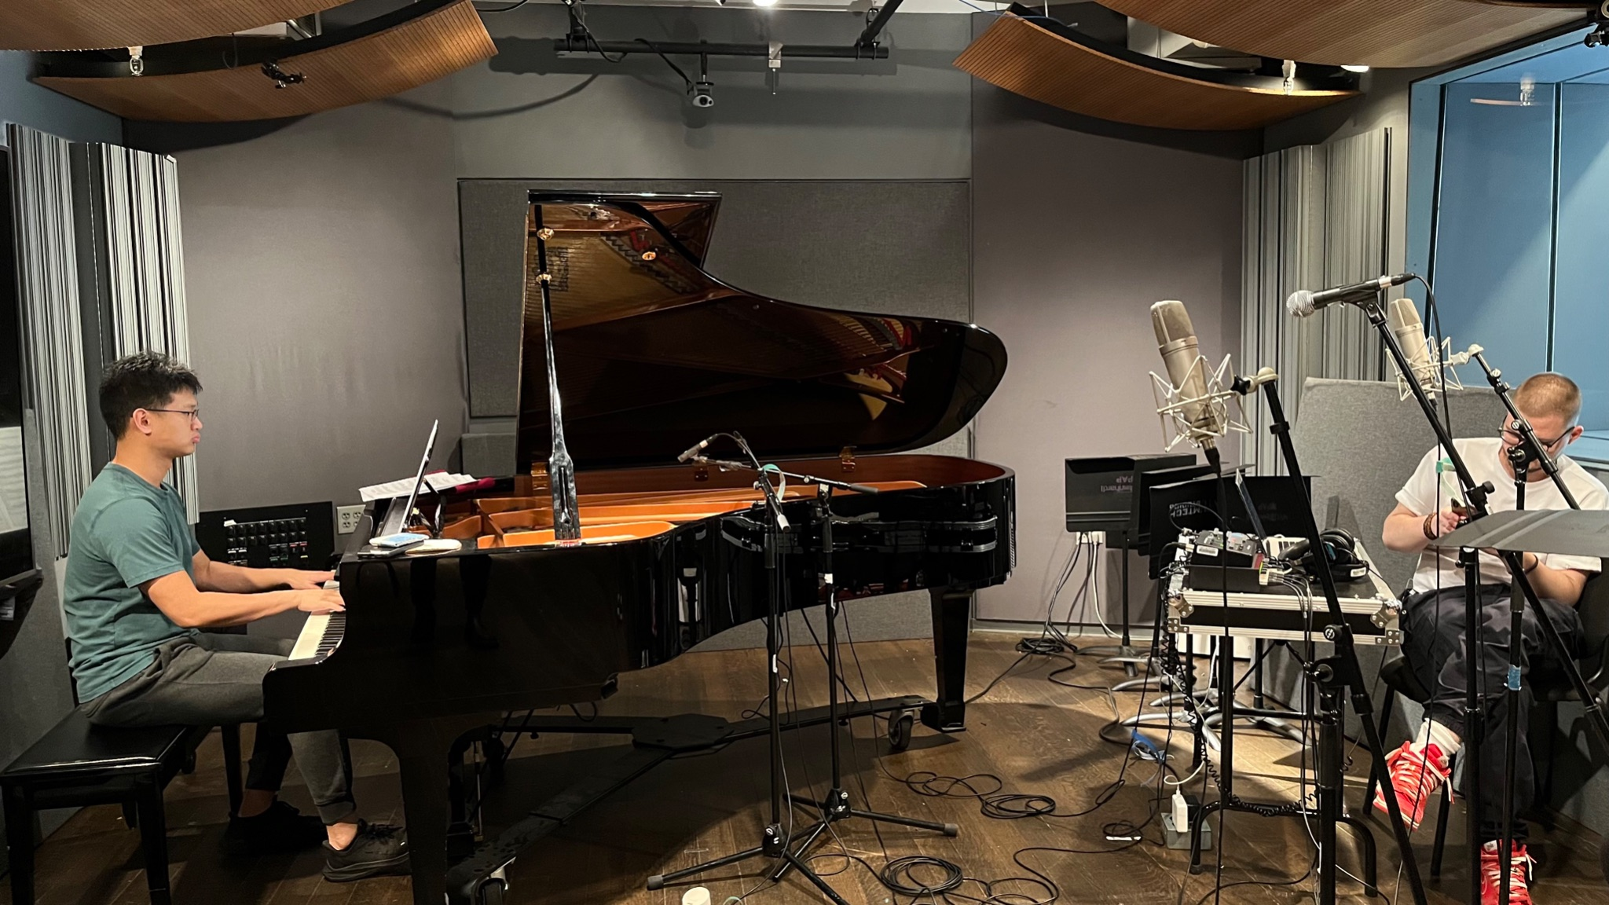
Notes:
greatest challenge while recording:
make sure both player for one piece plays comparable style, and play as faithfully to the original score as possible
which is hard!!!! we were always playing something wrong when we sight read
also: vary in dynamics and expression
pedaling as if we are driving a racecar lol

Slide 5
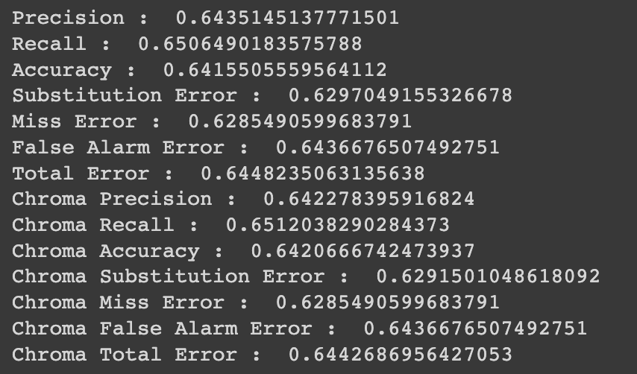
Coding and Data Processing
Compare: Estimation MIDI (estMIDI) vs Reference MIDI (refMIDI)
Parsing raw MIDI data for mir_eval.multipitch.evaluate() input
Evaluation Metrics: https://github.com/craffel/mir_eval/blob/master/mir_eval/multipitch.py
Precision
Recall
Accuracy
Notes:
the kind of input that multipitch evaluate takes
ref_time, est_time: 1-d array of time events
ref_freqs, est_freqs: 1-d array list of the same length, each element of the list is a np.ndarray of the freqs present in this
Parsing:
prerequisite: noticed that most ref and est MIDI pairs are comparable in length
-- all time frames slicing start at the beginning, and equal spacings -- governed by the fps parameter
-- demonstrate how to parse into frames
Fps oversampling warning: if the frame is too fine-grained and will generate too much spare frames in the discrepancy region - give warning and suggest suitable fps
for
End at: 2:00

Slide 6
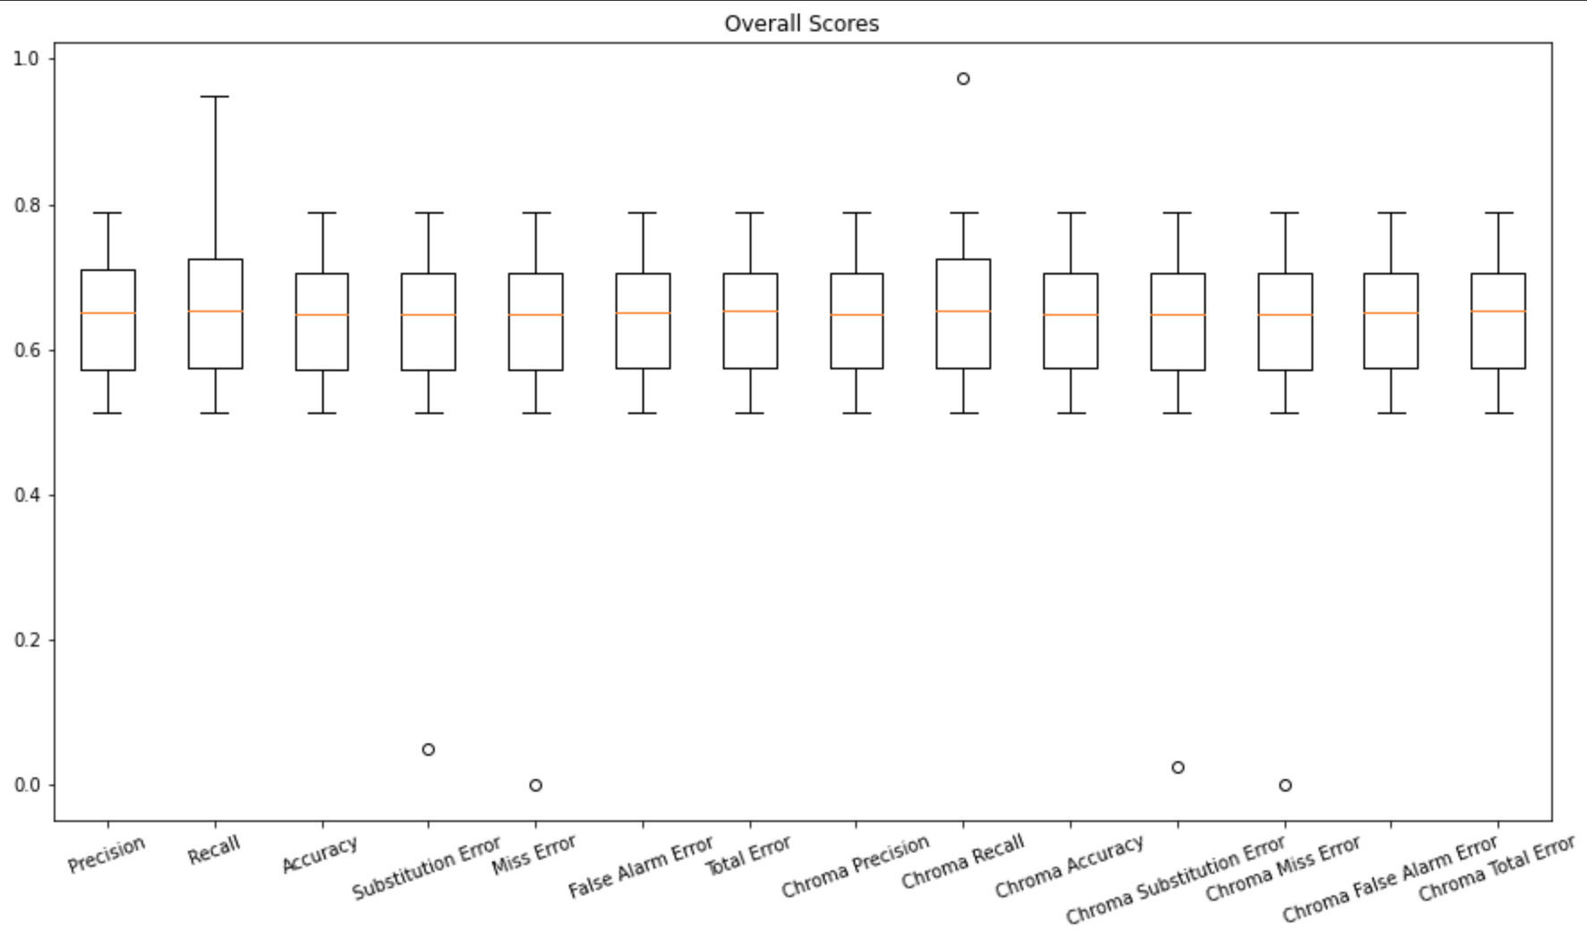
Result

Slide 7
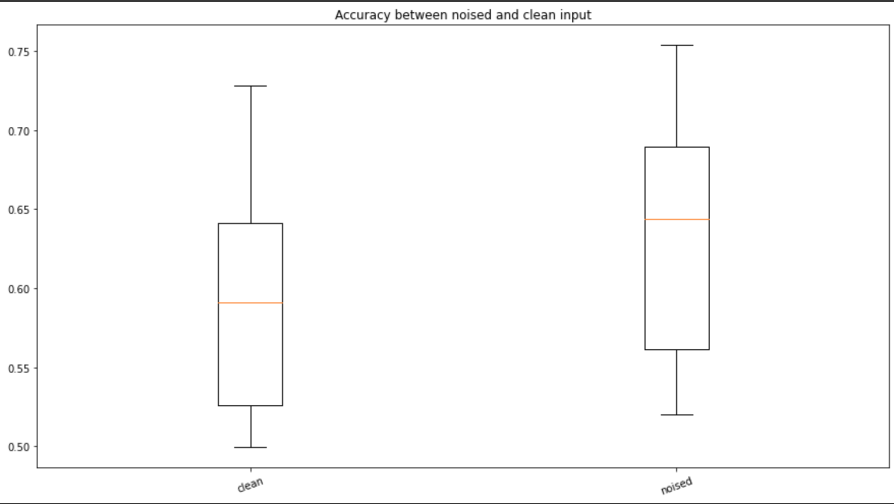
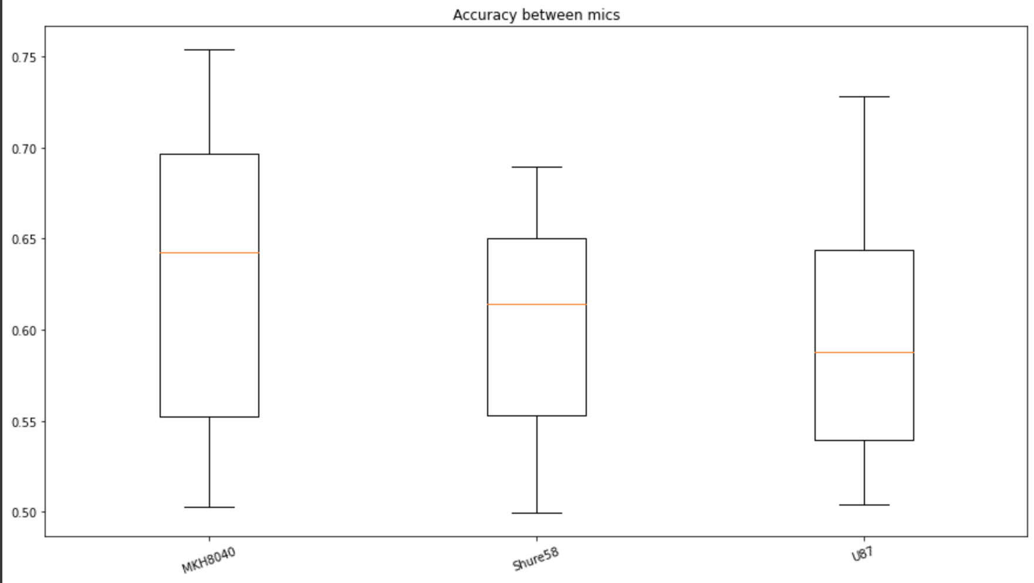
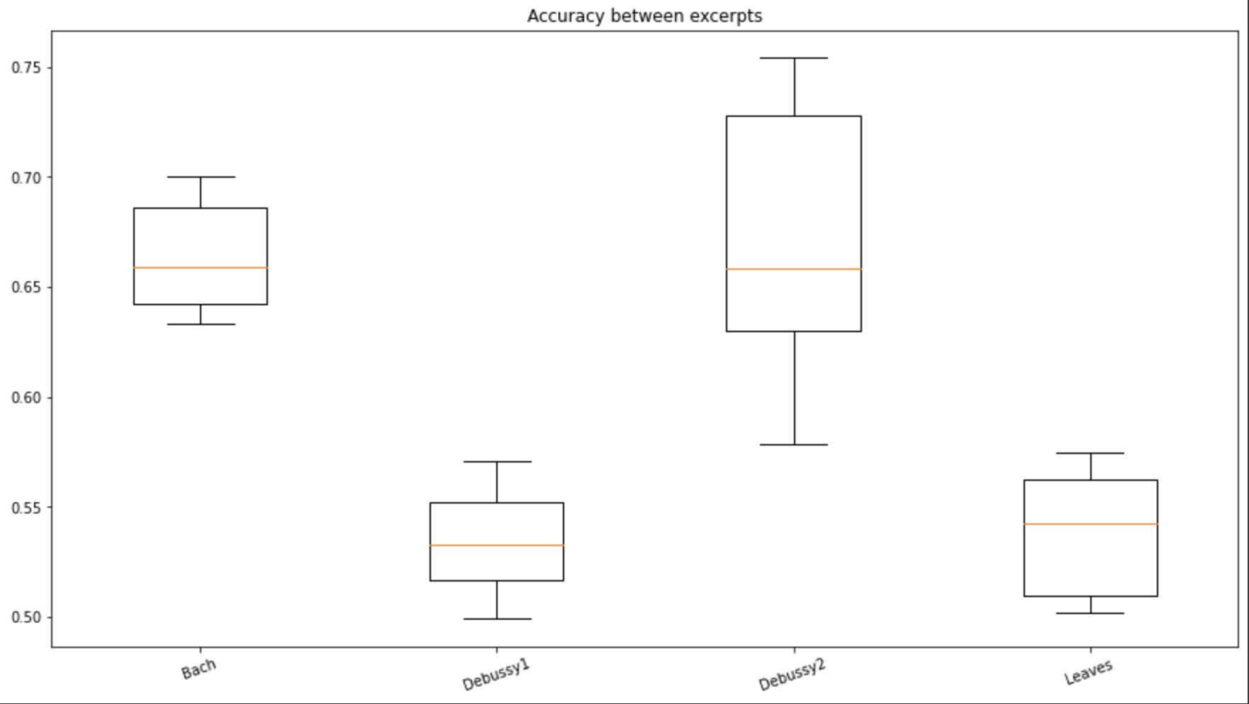
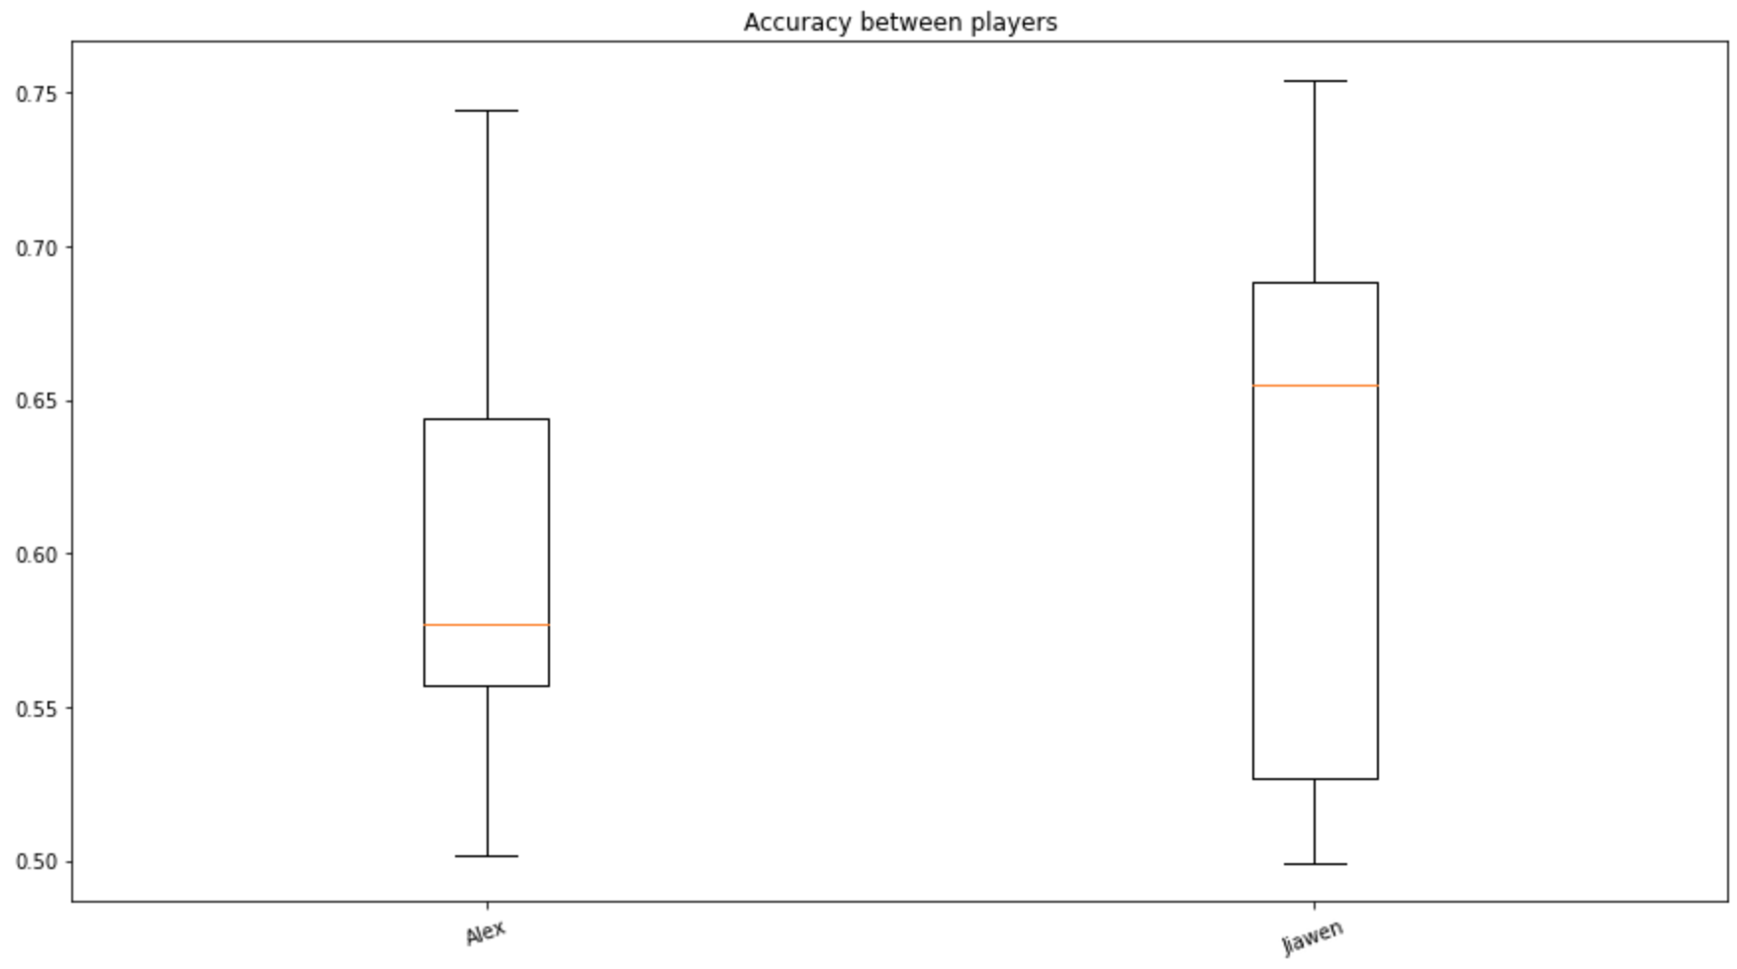
Notes:
End at: 2:30

Slide 8
Analyses and Observations
Compare audio quality: Noise helps?!
Compare pieces: Bach and Debussy2 significantly better than Debussy1 and Leaves
Compare microphones: Spot mic (MKH8040) wins
Compare players: Jiawen wins in overall accuracy, Alex is more consistent in quality
Notes:
explain everything!!!
Pedal reverb
End at: 3:30

Slide 9
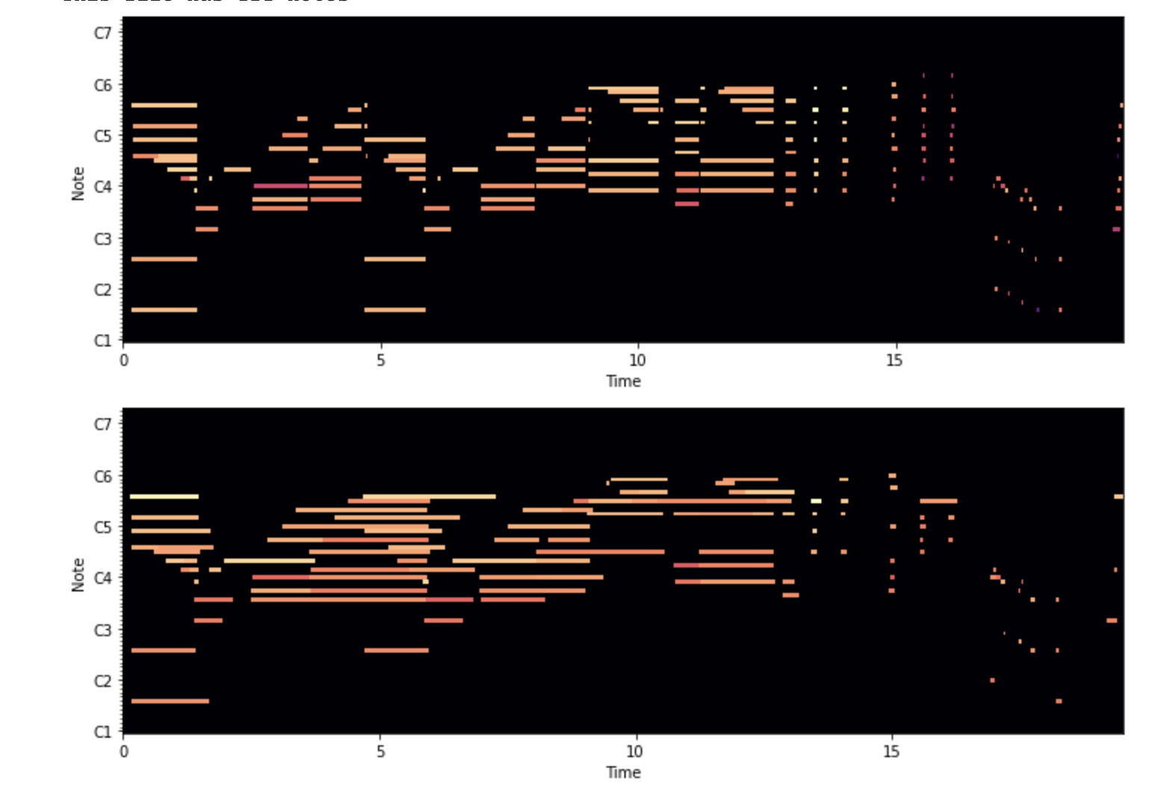
Analyses and Observations
Some Problems:
Missed predictions: Some notes are so quiet that the model doesn’t quite catch them
Masked harmonics: Arpeggio chord prediction results vary greatly
Elongated notes: Recorded MIDI has additional CC64 data but Piano Scribe translates pedaling as "longer note duration" – worse accuracy score
Notes:
End at: 4:00

Slide 10
Possible Improvement
Fine align two MIDI files before applying mir_eval.multipitch
Flexible parsing frame rate: both coarse- and fine-grain analysis
Piano Scribe to transcribe other instruments’ audio input: transcription accuracy is heavily reliant on timbre info

Slide 11
P.S. Used to be score_following?...
Why we failed:
Subjective reason: disastrous project and time management skills
Objective reason: disastrous GitHub reference for past papers

